Slide 1

Austin giving Connection
Connecting the fortunate to the people in need in your city

Slide 2
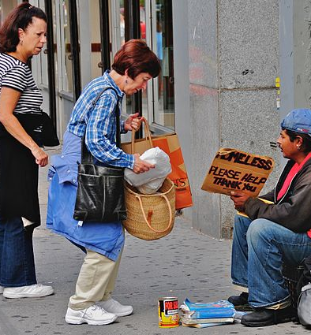
About Austin giving Connection
Austin Giving Connection provides a way for people in need or in crisis to receive help directly from other individuals.

Slide 3
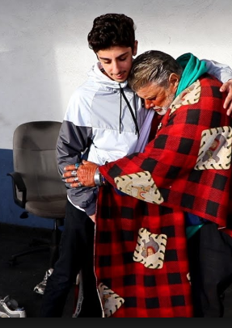
donors
Donors:
Do not have to create an account
Convenient (location)
Needs are Item specific
Witness the direct effect of their donation
Are able to cultivate a relationship with the person in need

Slide 4
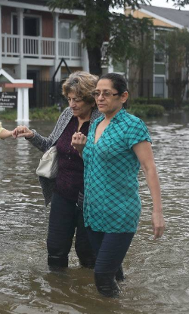
Person in need
Anyone in need can use this app including:
Chronically homeless
Teens aging out of the Foster Care System
Families or individuals experiencing substantial loss due to natural disasters such as floods or fire
Women and children fleeing from dangerous or unhealthy environments
Men and women transitioning back into society after incarceration
Refugees transitioning to the United States from other countries
Families or individuals experiencing financial loss due to critical illness

Slide 5
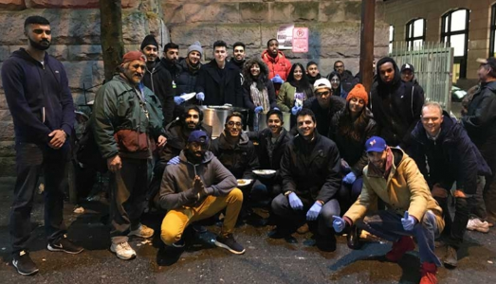
meetups
Additional feature for those in need to connect with one another.

Slide 6
What sets Austin giving Connection apart?
Versatility
Adaptability
Personal Connection
Notes:
Versatility – most websites or donation applications are limited a single charitable organization, non-profit or ministry. With this application, anyone in need can set create a profile and request help.
Adaptability - Because anyone can set up a profile in minutes, this application can meet the needs of large amounts of people in need. For example, if there are mass needs due to a natural disaster, like flood or fire AGW provides means to reach to donors needs within the few minutes it takes to create their profile. There is no red tape or pre-qualifications to meet prior to setting up a profile.
Personal Connection – Instead of donating a bag of random items to a charity or non-profit, AGW provides a Connection for the donor have a personal giving experience. The donor is able to select who receives their donation and provides an opportunity for relationships to develop between the donor and recipient. In this Connection, the donor receives greater satisfaction because they get to see the direct impact of their donation.

Slide 7
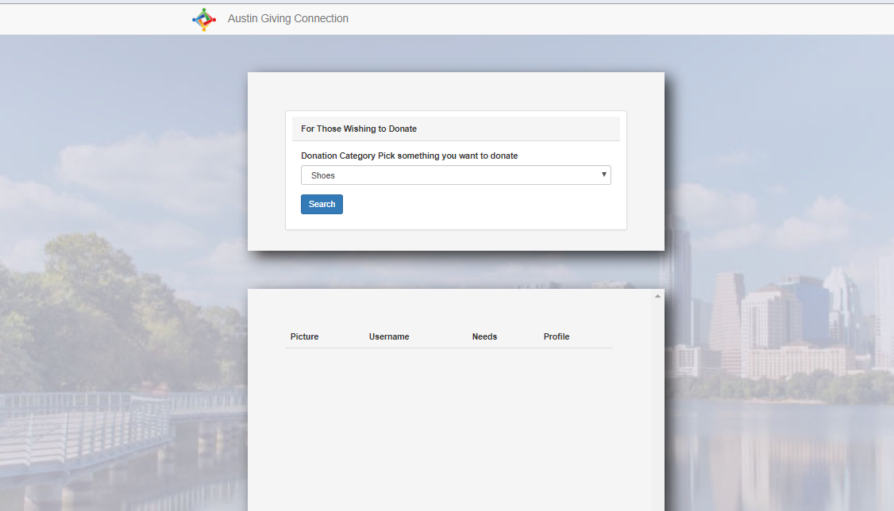
LIVE DEMONSTRATION

Slide 8
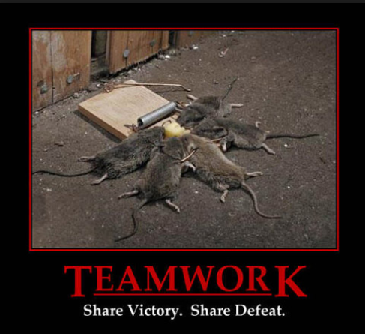
Team efforts how we delegated the work
GROUP MESSAGES through SLACK - OPEN COMMUNICATION
TRELLO – ORGANIZED DIVISION OF TASKS
FLEXIBILITY
ENCOURAGING AND COLLABORATIVE MINDSET
Notes:
FLEXIBILITY TO ASSIST EACH OTHER WITH WHATEVER WAS NEEDED AT ANY GIVEN TIME
ENCOURAGING AND COLLABORATIVE MINDSET

Slide 9
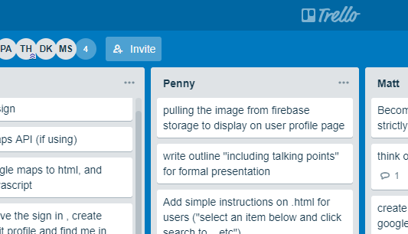
INDIVIDUAL RESPONSIBILITIES
Notes:
Individual Responsibilities
. Describe what
you
contributed to the project as an
individual—in other words, the parts of the project that you were accountable for.

Slide 10
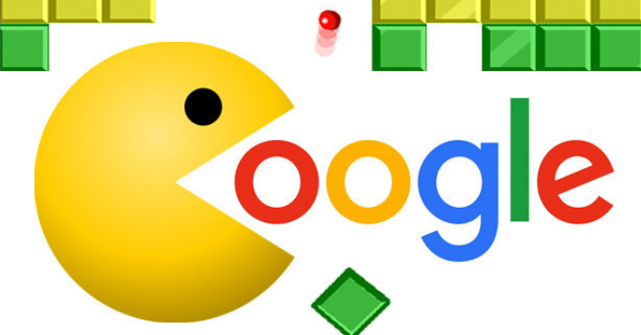
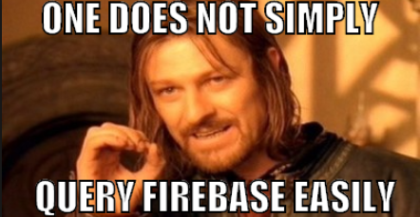
challenges
Google language and Firebase

Slide 11
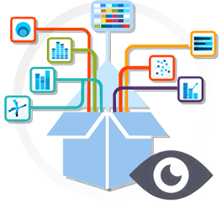
FUTURE FEATURES
Submit Image Functionality
Stripe API
In Create Account/ Things I Need, include Other Items with text box
Online Help tab
Expand Meetup API

Slide 12
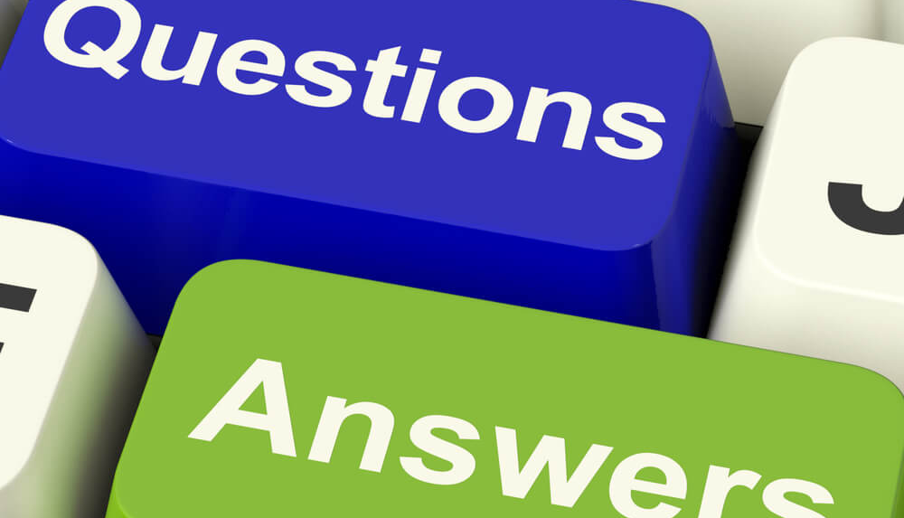
Questions?

Slide 13

5 ways to maximize happiness when giving
Give to very specific projects.
Give more frequently in smaller amounts.
Give with no strings attached.
Give when you know who your donation will help.
Give in public ways.
Science of Giving: An Experimental Approach to the Study of Charity
https://www.huffingtonpost.com/brady-josephson/want-to-be-happier-give-m_b_6175358.html

Slide 14

7 Scientific Benefits of Helping Others
HELPING OTHERS:
CAN HELP YOU LIVE LONGER.
MAKES US HAPPY.
MAY HELP WITH CHRONIC PAIN.
LOWERS BLOOD PRESSURE.
PROMOTES POSITIVE BEHAVIORS.
GIVES US A SENSE OF PURPOSE AND SATISFACTION.
ALTRUISM IS CONTAGIOUS.
From mentalfloss.com 7-scientific-benefits-helping-others

Slide 15
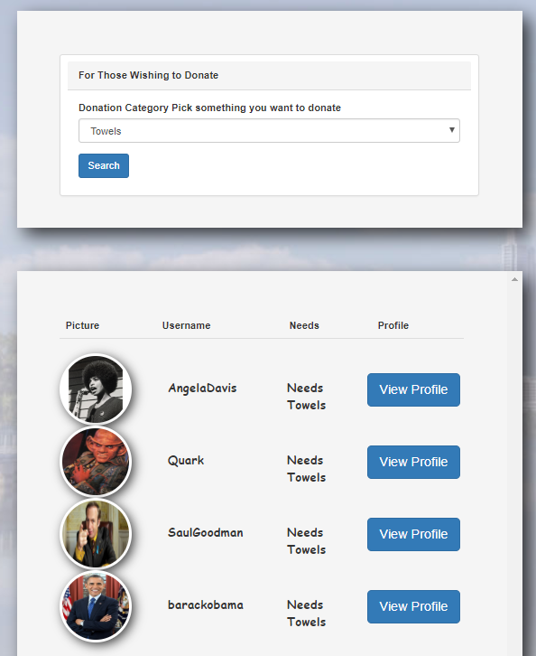
Search function
Click the drop-down arrow to select items you wish to donate.
Click Search to display results.
Results include recipient’s:
Picture
Username
Needs
Link to profile

Slide 16
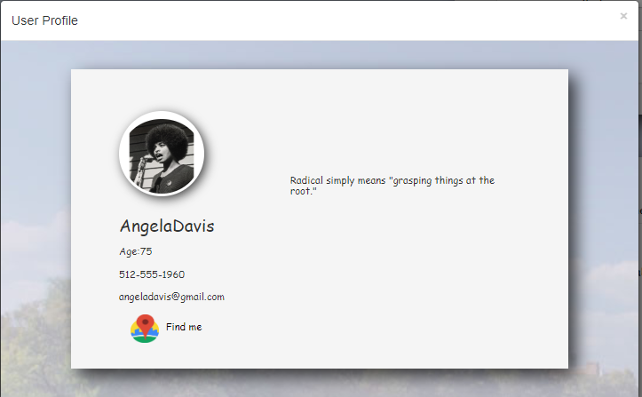
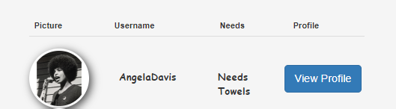
View Profile Button
Click the View Profile button to navigate to the recipients user profile.
View the recipient’s story, personal information and location in the User Profile modal.

Slide 17
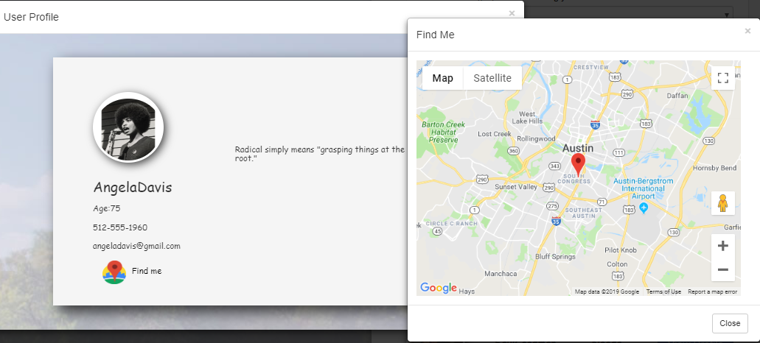
Location feature
From the User Profile modal, click Find me to access the general location of the recipient.
Click Close to return to search results.
Notes:
This feature is beneficial to donors, By knowing the location of the recipient, donors are able to determine if it is convenient to connect with the recipient.

Slide 18
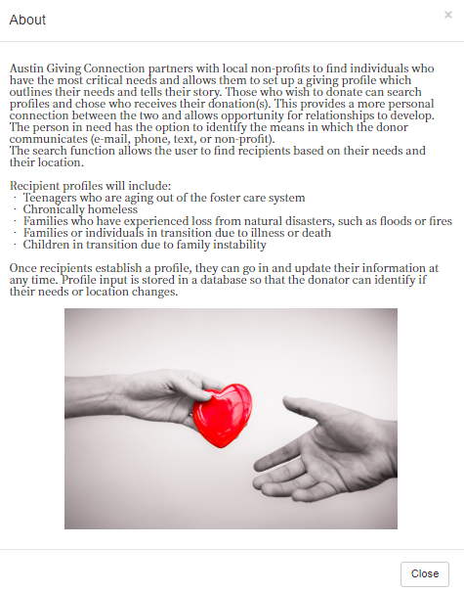
About tab
Click the About tab to display information about Austin Giving Connection.
Click Close to return to the Home page.

Slide 19
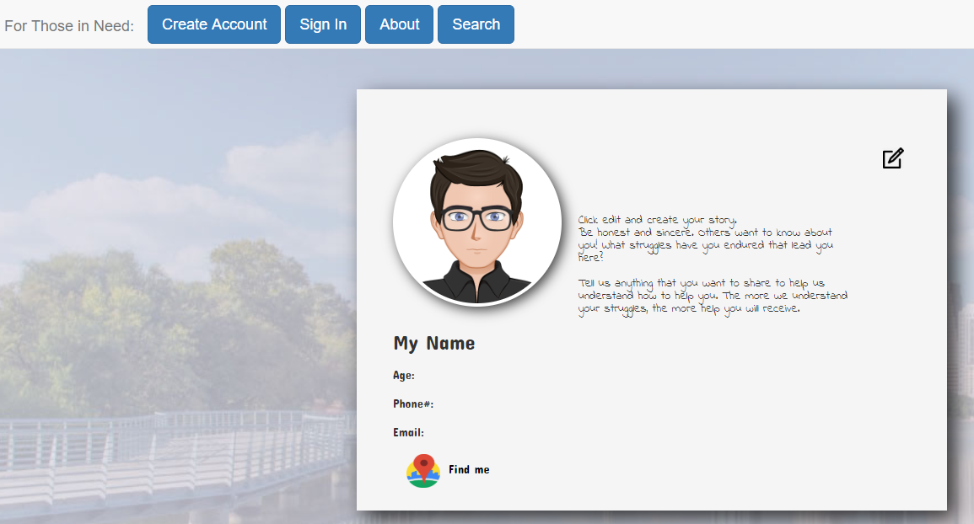

For those in Need Page
From the Home page, click the Need Account? Tab to navigation to For Those in Need Page.
Click Create Account.

Slide 20
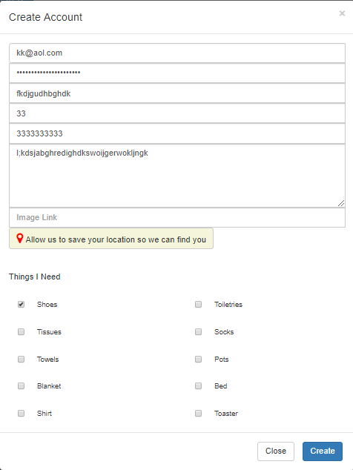
Create Account modal
Complete all fields.
Click Create.
Notes:
The person in need creates an account and can include items needed by clicking the radio boxes next to desired items. They can also include their location to make it easier for the donor to determine if it is convenient for them.
The person in need can also include a picture and tell their story. This gives the person in need the ability to tell others about their struggles so that the donor can better understand their needs and have compassion for them.

